Slide 1
Applying Machine Learning for Intrusion Detection in Network Security
Using Random Forest Algorithm
By
Rincy Mariam Thomas
Directory ID - rmt21
UID - 120124044
Course and Section - ENPM693 CY01

Slide 2
Introduction
Intrusion detection plays a crucial role in maintaining network security by identifying malicious activities.
The objective of this project is to apply machine learning techniques, specifically the Random Forest algorithm, for intrusion detection.
By leveraging the NSL-KDD dataset, the aim is to develop a model capable of accurately classifying network traffic as normal or intrusive.

Slide 3
Project Overview
Utilize the NSL-KDD dataset for consistency in comparisons across projects.
Dataset Source: NSL-KDD Dataset
Consistent Feature Selection:
Features:
@attribute 'src_bytes' real - Amount of data sent from the source to the destination.
@attribute 'dst_bytes' real - Amount of data sent from the destination back to the source.
@attribute 'protocol' {'tcp','udp', 'icmp'} - Communication protocol used.
Target Variable:
@attribute 'class' {'normal', 'anomaly'} - Identifies the class of network traffic as either 'normal' or 'anomaly', facilitating intrusion detection and security analysis.
Purpose:
Ensure uniformity in input data among all projects for meaningful comparisons.
Facilitate the evaluation of machine learning algorithms' performance.
Evaluate the performance of Random Forest and compare results with other algorithms like Isolation Forest, KNN, and K-Means.

Slide 4
What is Random Forest and Why Use It?
Random Forest is an ensemble learning method that constructs a multitude of decision trees during training and outputs the mode of the classes as the prediction.
By employing an ensemble learning approach, this project effectively reduces overfitting and enhances generalization by aggregating multiple decision trees' predictions.
Reasons for using Random Forest:
Robustness: Handles high-dimensional data with categorical and numerical features effectively.
Flexibility: Suitable for both classification and regression tasks.
Highlighting the versatility and performance of Random Forest sets the stage for its application in intrusion detection.

Slide 5
What is PCA and Its Purpose?
Principal Component Analysis (PCA) is a dimensionality reduction technique used to simplify complex datasets while preserving essential information.
Purpose of PCA:
Dimensionality Reduction: Reduces the number of features while retaining as much variance as possible.
Visualization: Projects high-dimensional data into a lower-dimensional space for easier visualization and interpretation.
Noise Reduction: Eliminates redundant or irrelevant features, enhancing model efficiency and performance.

Slide 6
Methodology - Without PCA
Preprocess the dataset by encoding categorical variables and scaling numerical features.
Train a Random Forest classifier using GridSearchCV for hyperparameter tuning.
Evaluate model performance using accuracy, confusion matrix, and classification report.

Slide 7
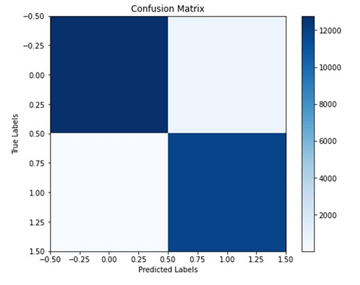
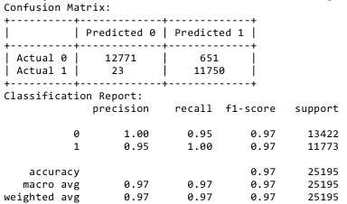
Results - Without PCA

Slide 8
Methodology - With PCA
Implement Principal Component Analysis (PCA) for dimensionality reduction.
Transform the dataset into a lower-dimensional space using PCA.
Train a Random Forest classifier on the reduced dataset.

Slide 9
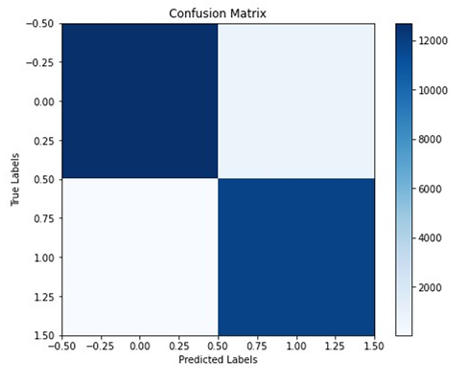
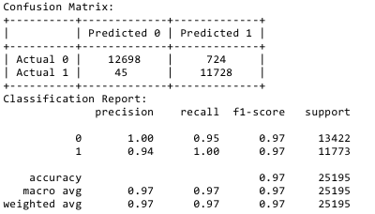
Results - With PCA

Slide 10
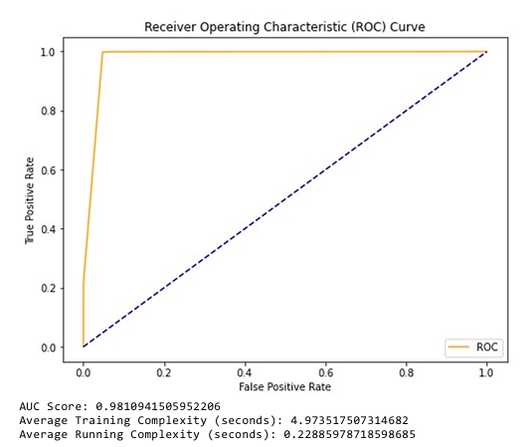
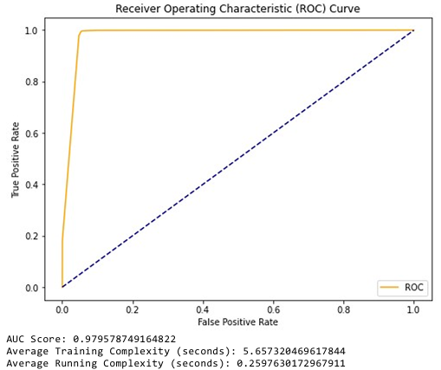
ROC, AUC & Complexity
This Random Forest model is performing exceptionally well in distinguishing between normal and intrusive network traffic. It achieves a high true positive rate while maintaining a low false positive rate, which is crucial for network security applications.

Slide 11
Performance Metrics Comparison
Algorithm | Accuracy | Precision | Recall
Random Forest | 97% | 97% | 97%
KNN | 97% | 97% | 97%
K-Means | 88% | 50% | 44%
Isolation Forest | 54% | 56% | 54%

Slide 12
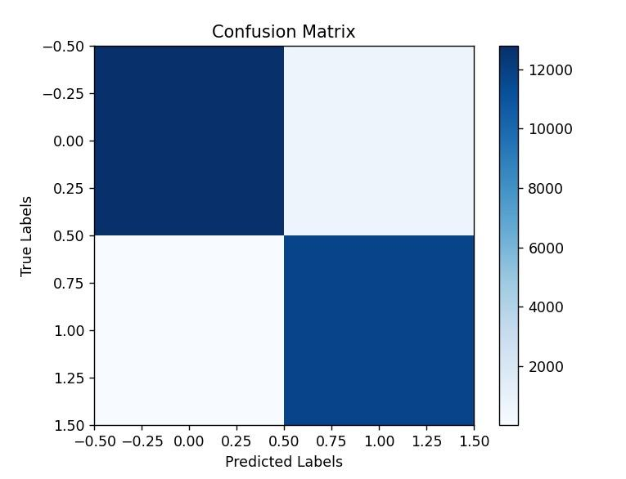
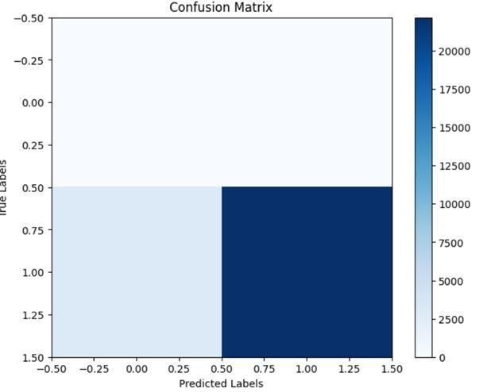
Confusion Matrix - K-Means & KNN
K-Means
KNN

Slide 13
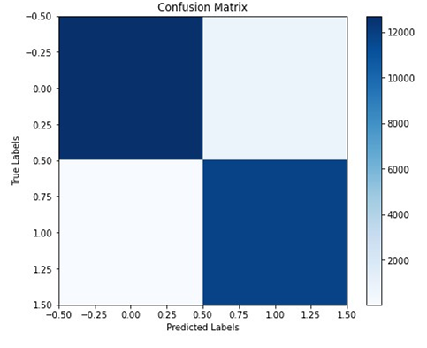
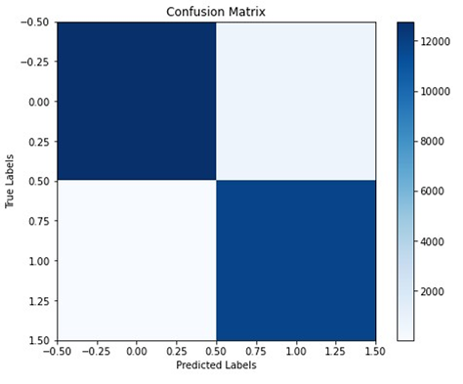
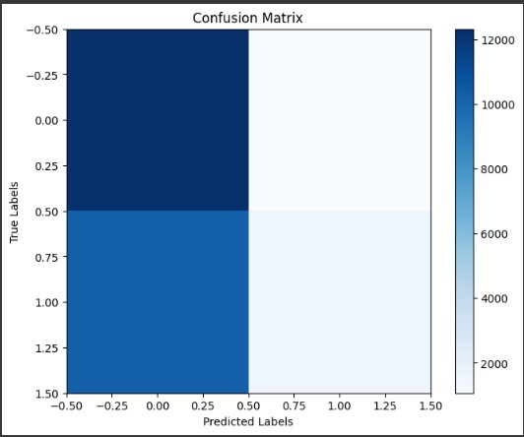
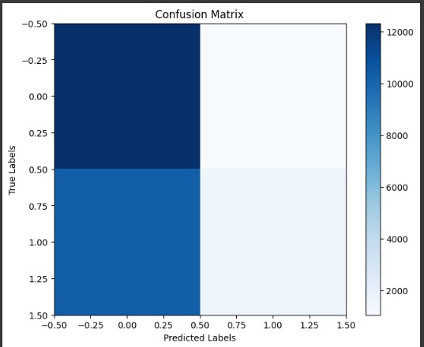
Confusion Matrix - Random & Isolation Forest
Algorithm | With PCA | Without PCA
Random Forest
Isolation Forest

Slide 14
Conclusion
Random Forest demonstrates promising results for intrusion detection in network security.
Leveraging machine learning techniques enhances our ability to detect and mitigate network threats.
Continued research and experimentation are essential for advancing intrusion detection systems.
Continuous exploration and refinement of the project will lead to more robust intrusion detection systems with higher accuracy and reliability.

Slide 15
Potential Improvements
Exploration of Feature Engineering:
Explore additional features or engineered features to enhance model performance.
Experiment with different feature selection techniques to identify the most relevant features.
Optimization of Hyperparameters:
Fine-tune hyperparameters further to improve the model's performance.
Utilize advanced optimization techniques like Bayesian optimization for efficient hyperparameter tuning.
Implementation of Ensemble Methods:
Investigate ensemble methods beyond Random Forest to leverage diversity in model predictions.
Explore techniques like stacking or boosting for improved accuracy and robustness.
Enhancement of Model Interpretability:
Implement techniques for model interpretability to gain insights into the decision-making process.
Utilize techniques like SHAP (SHapley Additive exPlanations) values or feature importance analysis.

Slide 16
References
NSL-KDD Dataset: NSL-KDD Dataset
GitHub Repository: My Project Repository Link
Research Papers:
https://ieeexplore.ieee.org/abstract/document/9778286
https://link.springer.com/article/10.1007/s00500-021-05893-0

Slide 17

Thank You!

